Slide 1


Day 1 Introduction to UNIX command-line
Serghei Mangul, Ph.D.
University of California, Los Angeles
@serghei_mangul

Slide 2
Introduction to UNIX command-line
Day 1
Unix - Learning the essentials
Unix fundamentals , syntax and usage
Day 2
Unix commands
Useful tools for processing text files
Day 3
Useful shell commands
UNIX Shell Scripting

Slide 3
Learning Objectives
By the end of this module, students will be able to:
List the attributes of Unix that make it ideal for addressing complicated biological questions using computers
Compare and contrast the Command Line Interface (CLI) vs the Graphical User Interface (GUI)
Identify the uses of the multiple UNIX commands
pwd, mkdir, and cd and use them to navigate within the UNIX file system

Slide 4
Introduction to UNIX Command Line: Learning Objectives
By the end of this module, students will be able to:
Perform the following tasks within the UNIX environment:
Create a text file
List and reorder files
Display, copy, move, and delete directories and files
Use grep command to search text in the txt files
Use awk to process tab delimited files
Use sed to edit text in the txt files

Slide 5
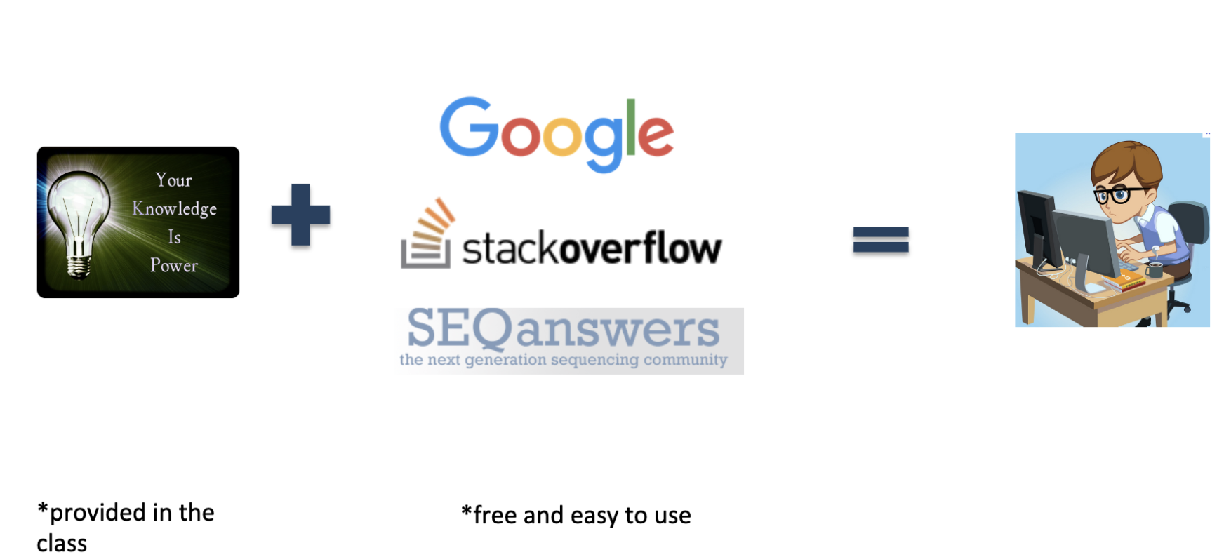
Do biomedical researchers have to become programmers?

Slide 6
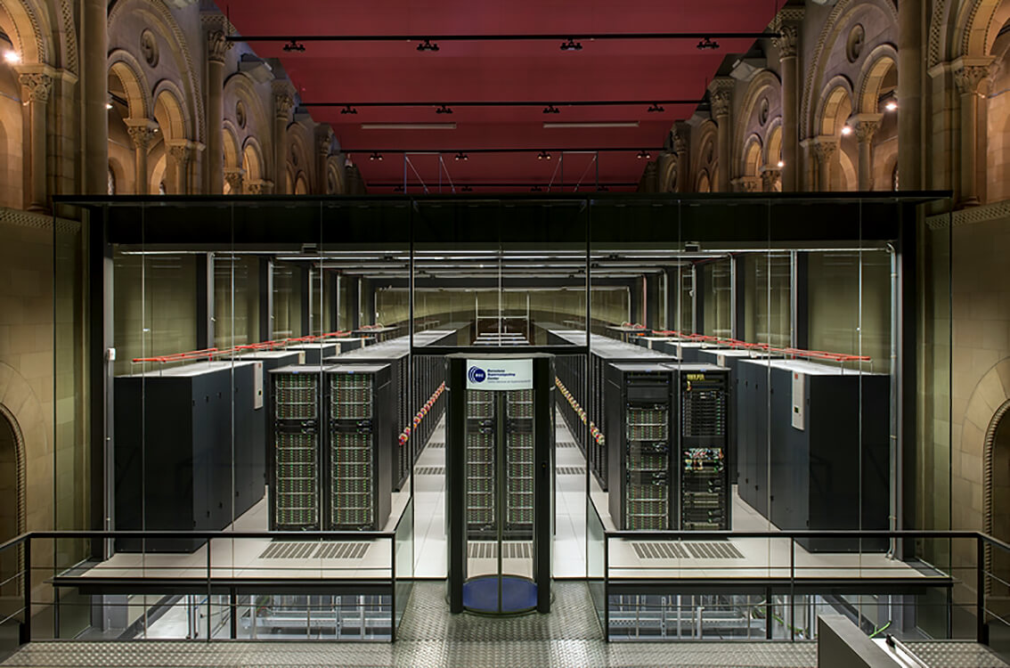
Why Learn Unix?
As biological data sets have grown larger and biological problems have become more complex, the requirements for computing power have also grown.
Computers that can provide this power generally use the Unix operating system
BSC-CNS | Barcelona Supercomputing Center

Slide 7
Why Learn Unix?
Most new bioinformatics software is created for Unix
Unix is very efficient
manage extremely huge amounts of data
It is very popular, so it is easy to find information and get help
Unix is very stable - computers running Unix almost never crash
Notes:
Unix is used by most large, powerful computers
Graphical User Interface at Mac and Windows
Unix – command line interface, called shell

Slide 8
Why not MS Excel?
Excel is good for simple tasks and small datasets
Excel is not eble to handle large datasets above 1,048,576 rows and 16,384 columns
Excel is not suitable for large number of datasets.

Slide 9
What is Unix?
UNIX-like system (e.g Linux, Ubuntu) is a type of operating system that lack a graphical interface and require inputting code.
UNIX environment is often is referred as command line interface opposed to graphical interface, which is common for Windows and MacOS.

Slide 10
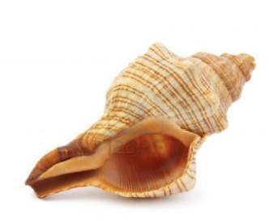
The Unix Shell
A shell is a program that waits for you to type a command and then executes it.
type the command, then “return”
Notes:
Try to type anything

Slide 11
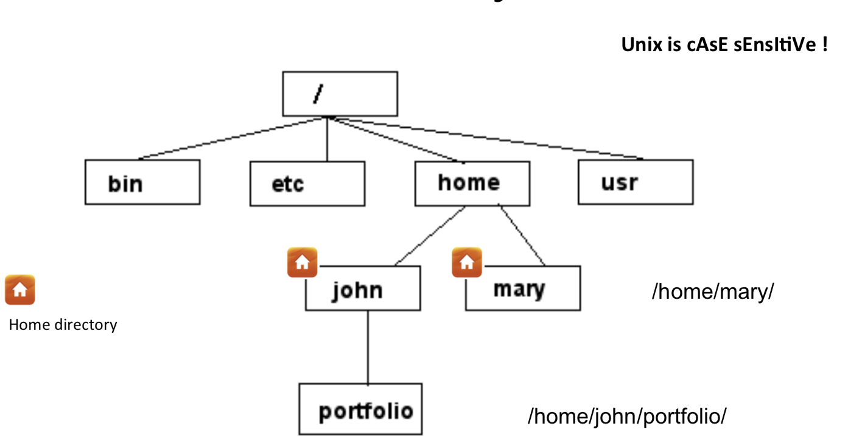
Unix File System
my home directory
path
My laptop : /Users/serghei
Notes:
Folders - >dir
Type pwd

Slide 12

Home directory
When you open terminal, you always start in your Home directory.
Create sub-directories in your home or other directory to store specific projects or groups of information
Do not accumulate thousands of files with cryptic names in your Home directory

Slide 13
Command: pwd
To display current directory
[serghei@login3 ~]$ pwd
/u/home/s/serghei
Notes:
Since it is command line interface let’s learn few commands

Slide 14

How to run UNIX
Use Jupyter notebook on Google Collaboratory

Slide 15
Why?
In certain cases, installing UNIX (Ubuntu) on Windows might be challenging
Cloud is an alternative allowing to run UNIX and Python on any computer regardless of the operating system
Why?

Slide 16
Steps
Open google/gmail account if you don’t have one
Go to https://colab.research.google.com/

Slide 17
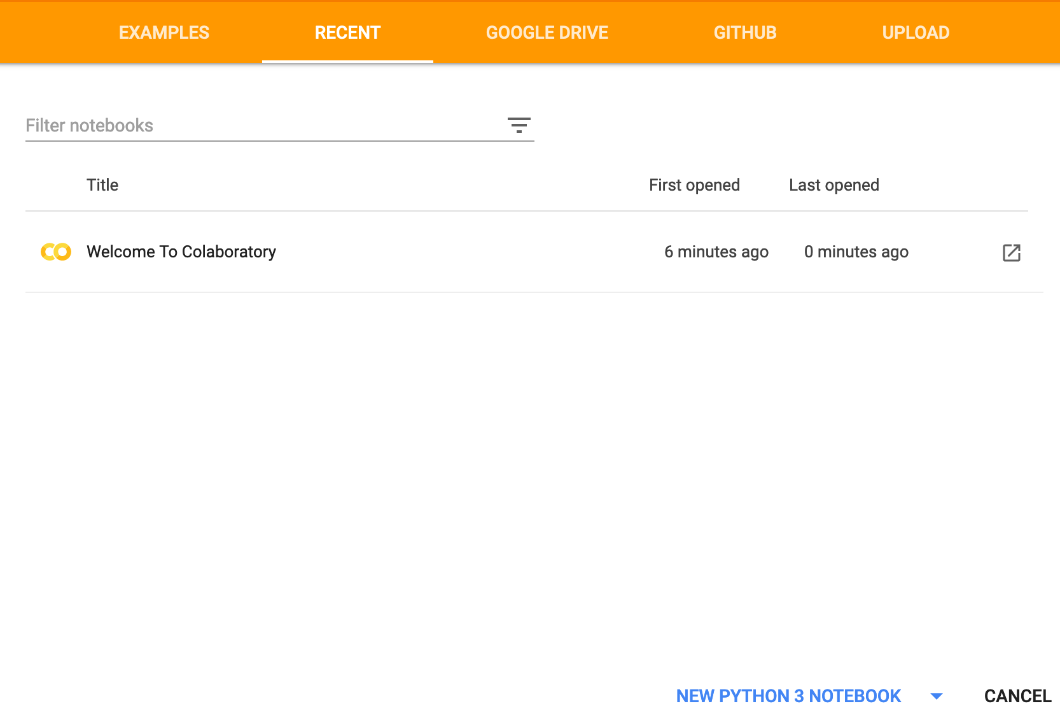
Colaboratory - Google
Allows to use UNIX and Python with no prior installation
Using Jupyter notebooks
https://colab.research.google.com/

Slide 18
Run jupyter notebook
Click

Slide 19
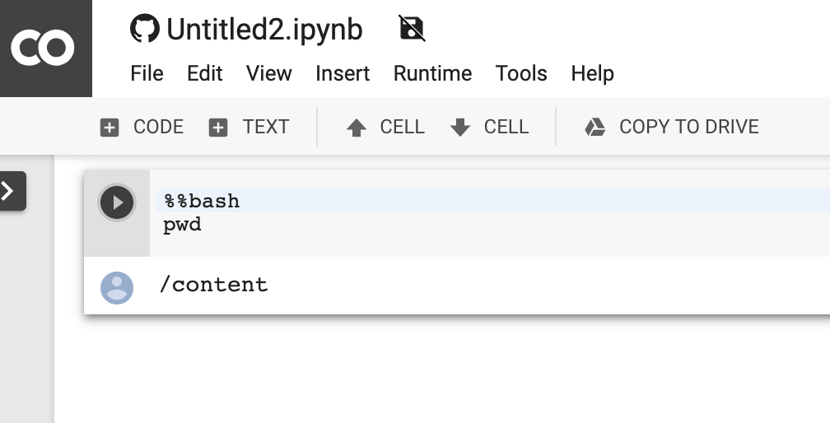
Run UNIX command in notebook
Click

Slide 20
Add new code cell
Click

Slide 21
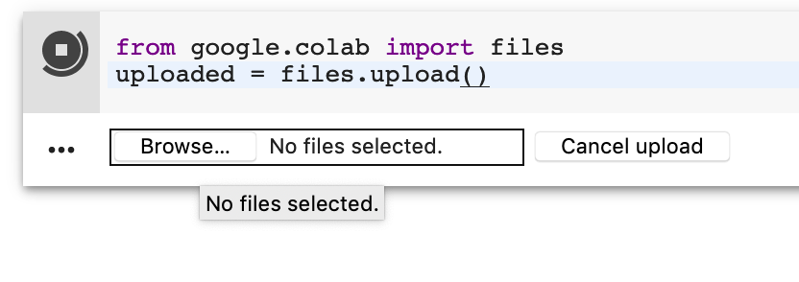
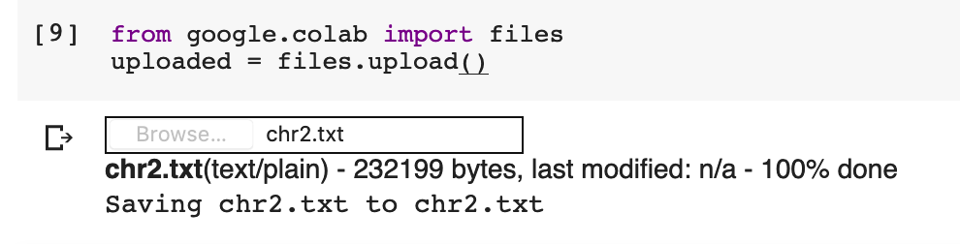
Upload files
from google.colab import files
uploaded = files.upload()
Select file you want to upload
Confirmation that the file was successfully uploaded

Slide 22
You can run any UNIX command now

Slide 23

Command: mkdir
To create a new directory use “mkdir”
[serghei@login3 ~]$ mkdir test
If no error message is displayed means the command was run successfully

Slide 24
Command: cd
cd changes your current working directory
cd test
pwd
/u/home/s/serghei/test
Notes:
cd t “tab”, to auto-complete file names, use the tab key

Slide 25
Command: cd
“~” is the location of your home directory
“..” is the location of the directory above the current one
/Users/serghei
my home directory
/Users/serghei/test
/Users/serghei/test

Slide 26

Let’s practice
[serghei@login3 test]$ cd ~
[serghei@login3 ~]$ pwd
/u/home/s/serghei
[serghei@login3 ~]$ cd ..
[serghei@login3 s]$ pwd
/u/home/s
[serghei@login3 s]$ cd
/u/home/s/serghei

Slide 27


to go back to previously entered commands, use the up and down arrows
to auto-complete file names, use the tab key
if you are stuck within a command/process/program, try ctrl-z to terminate it

Slide 28
Let’s practice
mkdir jdkhfkjdsfhkjsdhfkjsdhfkjhs
cd jdkhfkjdsfhkjsdhfkjsdhfkjhs

Slide 29
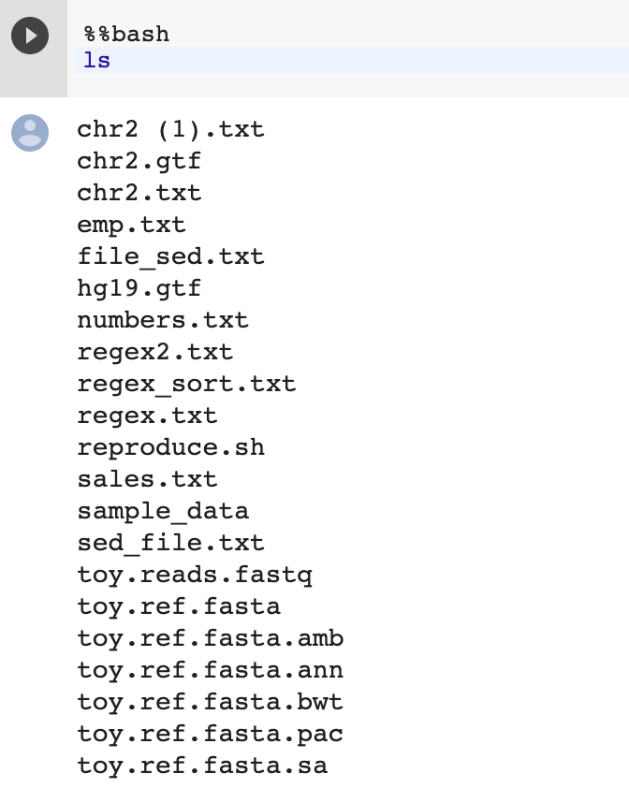
Command : ls
to list the files in the current directory
ls
Notes:
Different color

Slide 30
Command : ls
ls has many options
-l long list (displays lots of info)
-t sort by modification time
-S sort by size
-h list file sizes in human readable format
-r reverse the order
Options can be combined: “ls -lh”
Notes:
Whenever you need help with a command type “man” and the command name

Slide 31
Let’s practice!
[serghei@login3 test]$ ls
jdkhfkjdsfhkjsdhfkjsdhfkjhsdjfk test.txt
[serghei@login3 test]$ ls -l
total 8
drwxr-xr-x 2 serghei eeskin 4096 Sep 8 09:35 jdkhfkjdsfhkjsdhfkjsdhfkjhsdjfk
-rw-r--r-- 1 serghei eeskin 80 Sep 8 09:50 test.txt
[serghei@login3 test]$ ls -lh
total 8.0K
drwxr-xr-x 2 serghei eeskin 4.0K Sep 8 09:35 jdkhfkjdsfhkjsdhfkjsdhfkjhsdjfk
-rw-r--r-- 1 serghei eeskin 80 Sep 8 09:50 test.txt
Notes:
Many option might be confusing, how to get help!

Slide 32
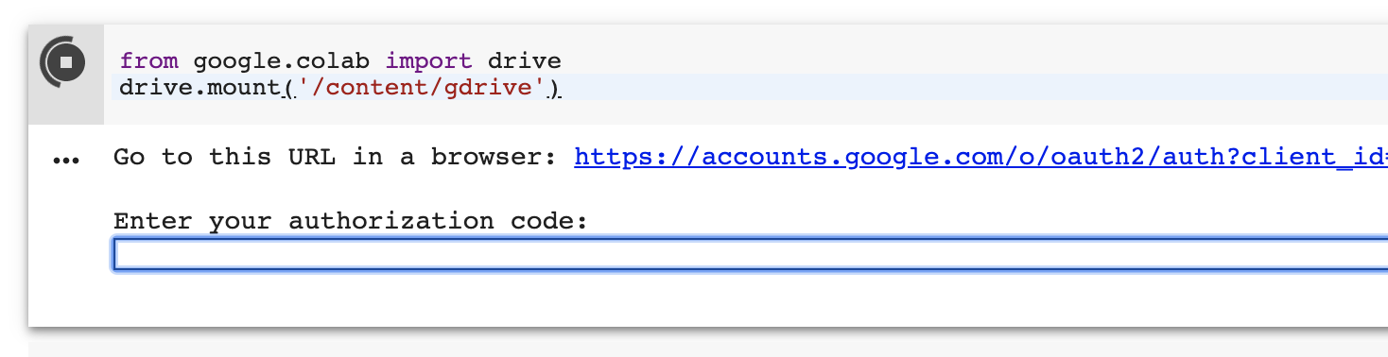
Download files
from google.colab import drive
drive.mount('/content/gdrive')
Click

Slide 33
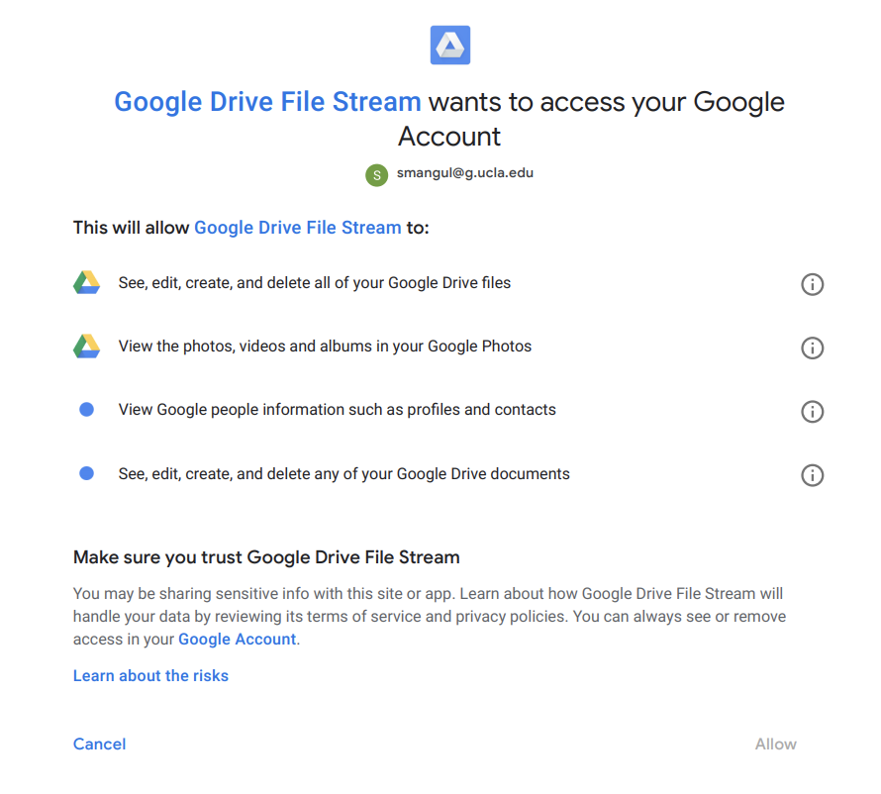
Click

Slide 34
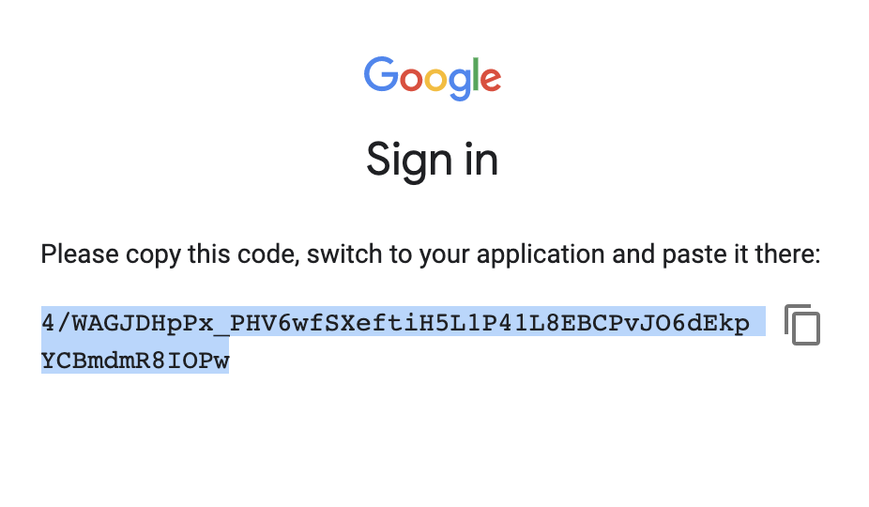
Click to copy text

Slide 35
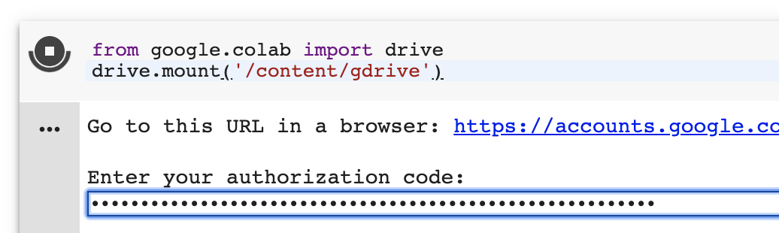
Connect notebook with Google Drive
Paste and click ENTER/RETURN

Slide 36
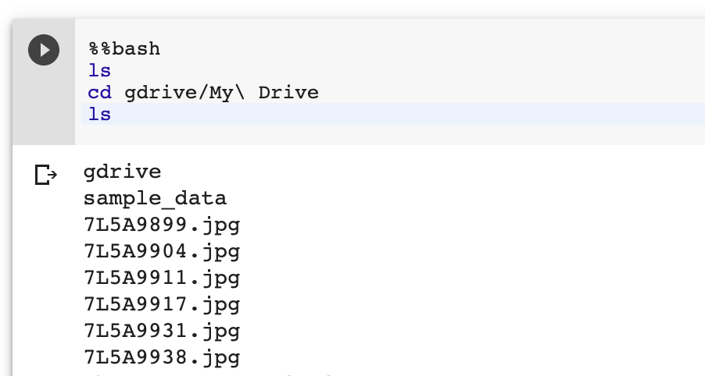
Access Google drive from notebook

Slide 37
How to know more?
Manual
Google

Slide 38
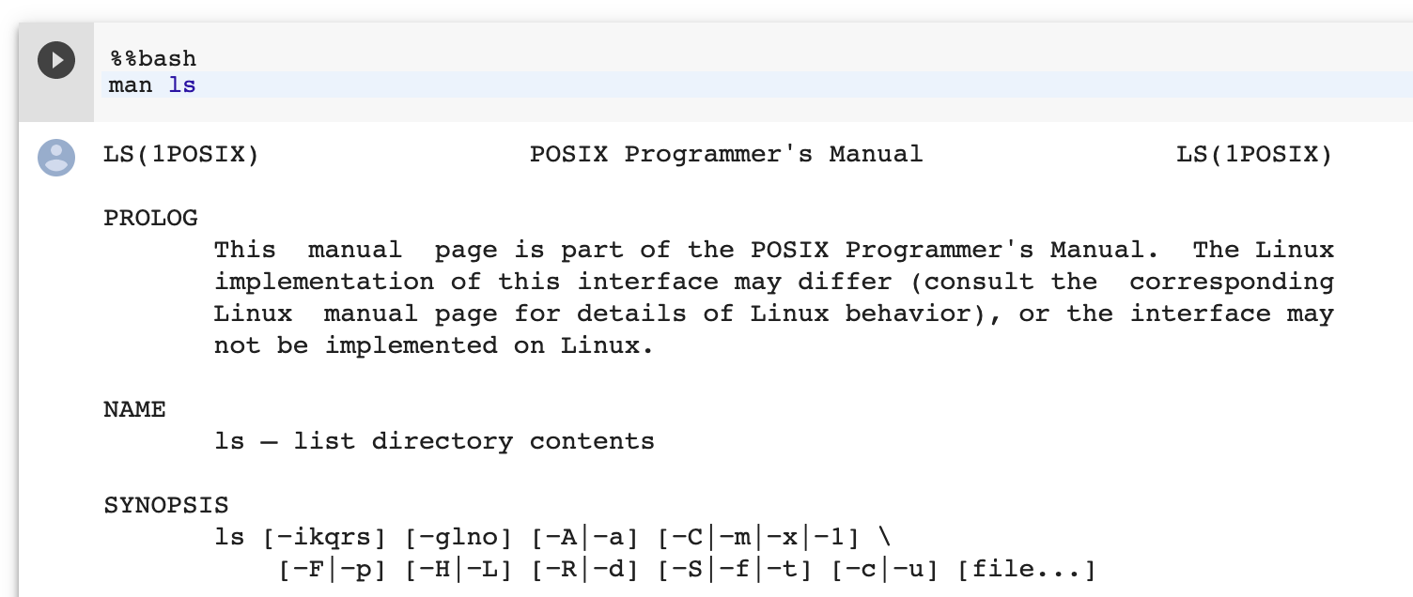
Command : man
displays manual pages
man ls
q to exit

Slide 39
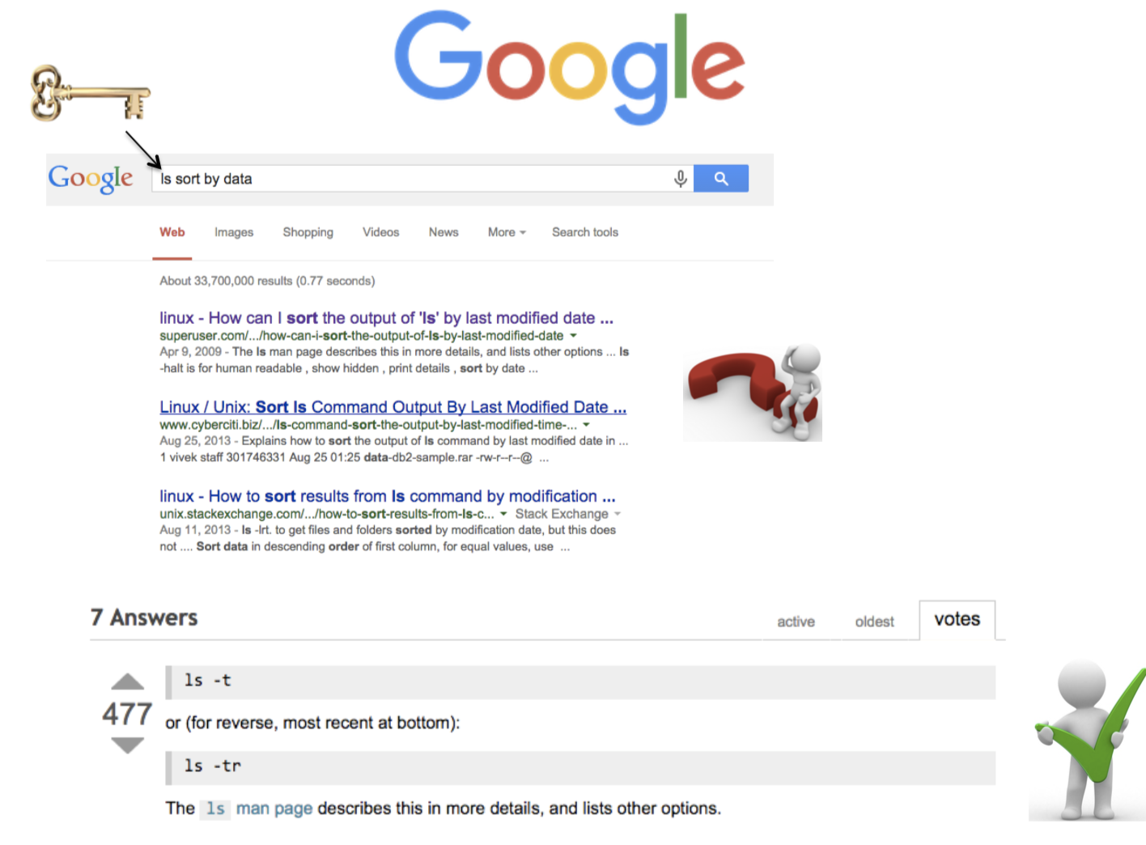

Slide 40
General Syntax: *
“*” can be used as a wildcard in Unix
[serghei@login3 test]$ ls *txt
test.txt
[serghei@login3 test]$ ls t*g
test.log
[serghei@login3 test]$ ls t*
test.log
test.txt

Slide 41
Displaying a file
Various ways to display a file in Unix
cat
less
head
tail

Slide 42
Command: cat
dumps an entire file to standard output
good for displaying short, simple files
[serghei@login3 test]$ cat test.txt
My first txt file!

Slide 43
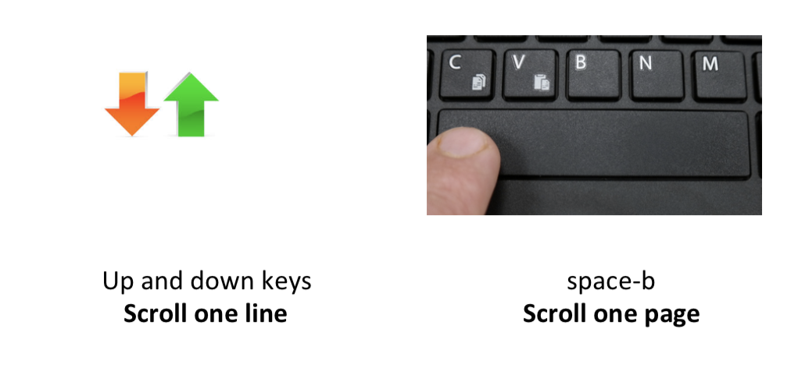
Command: less
Scrolling through a file without a mouse
press q to exit

Slide 44

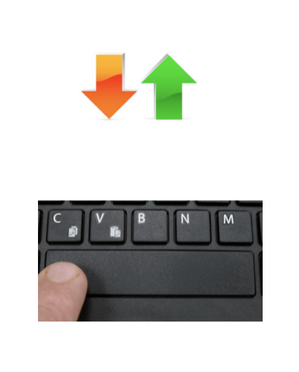
Let’s practice!
[serghei@login3 test]$ less large.txt
1
2
3
4
5
6
7
…
30
Try to scroll forward/back one line/page!

Slide 45
Command: head
displays the top part of a file
by default it shows the first 10 lines
-n option allows you to change that

Slide 46
Command: tail
Same as head, but shows the last lines

Slide 47
Let’s practice!
head large.txt
1
2
…
9
10
tail large.txt
21
22
…
30
tail -n 3 large.txt
28
29
30

Slide 48



File Commands
Copying a file: cp
Move or rename a file: mv
Remove a file: rm
Notes:
Like so many Linux features, you have a variety of options from which to choose when you want to manipulate files and directories. You can also use wildcards when you're copying, moving, or deleting files and directories.

Slide 49
Copy
cp <source> <destination>
to copy a file use cp
to copy a directory use cp -r

Slide 50
Let’s practice
[serghei@login3 test]$ cp test.txt test1.txt
[serghei@login3 test]$ ls
large.txt test1.txt test.log test.txt
[serghei@login3 test]$ mkdir new
[serghei@login3 test]$ cp -r new new2
[serghei@login3 test]$ ls
large.txt new new2 test1.txt test.log test.txt
[serghei@login3 test]$ cp test.txt new/
[serghei@login3 test]$ cp test.txt new/test_new.txt
[serghei@login3 test]$ cd new
[serghei@login3 new]$ ls
test_new.txt test.txt
Notes:
Creating a copy of a file in the current directory

Slide 51

Command: mv
mv <source> <destination>
moves a file/directory to a different location
renames a file/directory
[serghei@login3 new]$ cd ..
[serghei@login3 test]$ pwd
/u/home/s/serghei/test
[serghei@login3 test]$ mv test1.txt new/
[serghei@login3 test]$ mv test.txt test_rename.txt
[serghei@login3 test]$ ls
large.txt new new2 test.log test_rename.txt
[serghei@login3 test]$ mv test.txt new/test2.txt

Slide 52
Symbolic Links
is a special kind of file that points to another file
existing file for which you want to create the symbolic link
name of the symbolic link
ln -s <ORIGINAL_FILE> <LINK_NAME>
Original file
Link
Data on the hard disc

Slide 53


Good to know
You can perform an operation on LINK_NAME, just as you could with the ORIGINAL_FILE
You can use normal file management commands (e.g., cp, rm) on the symbolic link.
Don’t modify the original file through the link

Slide 54


Command: rm
to remove a file use rm
to remove a directory use rm -r
[serghei@login3 test]$ rm test.log
[serghei@login3 test]$ rm -r new2
[serghei@login3 test]$ ls
large.txt new test_rename.txt
Files and directories deleted with rm are gone forever and cannot be recovered!!!

Slide 55
Good to know
cp/mv/rm can work on many files at once:
cp file1 file2 new/
rm file1 file2 file27
cp/mv/rm can work with *:
mv f* new/
rm f*
rm l*s
rm *txt

Slide 56
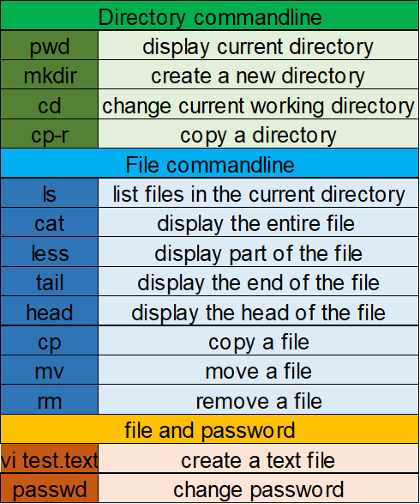
Summary

Slide 57

Create directory “practice” in your home directory
Inside directory “practice” create files p.a and p.b
Create a copy of file p.a(p_copy.a) and rename file p.b (new name : practice.b)
Delete all files ending with b
Notes:
passwd

